Slide 1
Lecture 8b: Cache Performance
To watch lecture video click link below
Lecture 8b video
To view slides, continue to next slide

Slide 2
Lecture 8b: Cache Performance
Outline:
Cache overhead
Impact to CPI by cache miss penalty
Strategies for improving cache performance

Slide 3
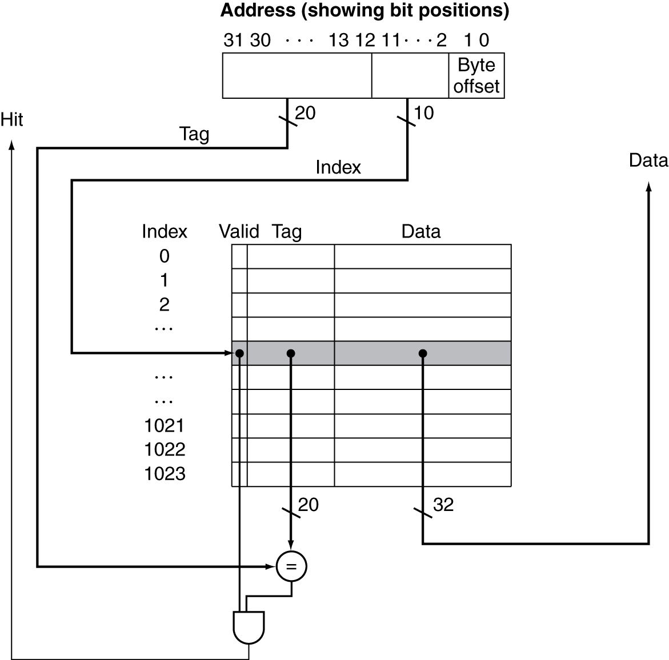
Implementation of Direct-mapped Cache
Cache overhead
A 4KB cache

Slide 4
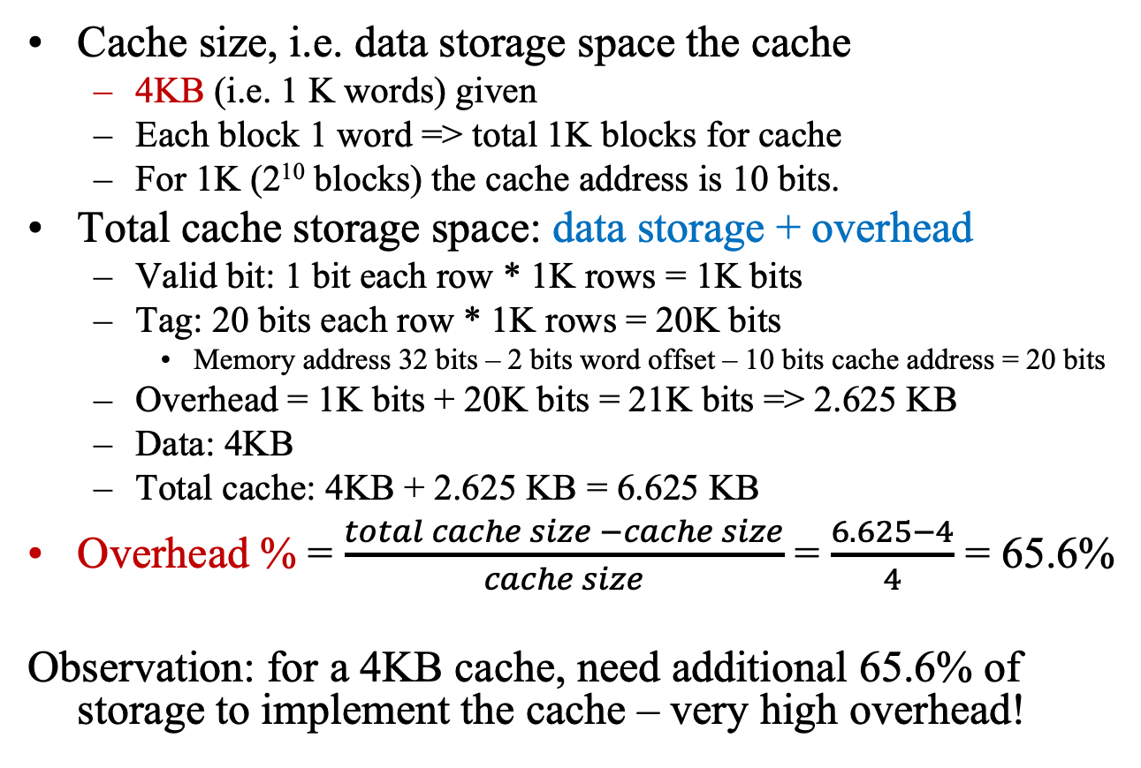
Cache Overhead
Cache size, i.e. data storage space the cache
4KB (i.e. 1 K words) given
Each block 1 word => total 1K blocks for cache
For 1K (2¹⁰ blocks) the cache address is 10 bits.
Total cache storage space: data storage + overhead
Valid bit: 1 bit each row * 1K rows = 1K bits
Tag: 20 bits each row * 1K rows = 20K bits
Memory address 32 bits – 2 bits word offset – 10 bits cache address = 20 bits
Overhead = 1K bits + 20K bits = 21K bits => 2.625 KB
Data: 4KB
Total cache: 4KB + 2.625 KB = 6.625 KB
Overhead % = $\frac{total cache size −cache size}{cache size}$ = $\frac{6.625−4}{4}$ = 65.6%
Observation: for a 4KB cache, need additional 65.6% of storage to implement the cache – very high overhead!

Slide 5
Practice: Calculating Cache Size
How many total storage needed to implement a directed-mapped cache with 64KB of data with one-word per block, assuming a 32-bit memory address?
Note: in previous example, word offset 2 bits meant that the last two bits of a word address always 00.
Remember: memory are byte addressed and words are aligned so must start at an address of multiple of 4.

Slide 6
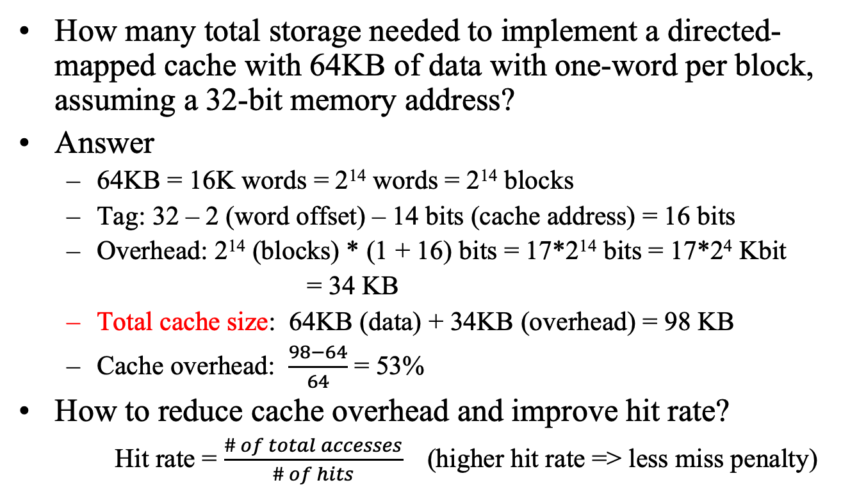
Practice: Calculating Cache Size
How many total storage needed to implement a directed-mapped cache with 64KB of data with one-word per block, assuming a 32-bit memory address?
Answer
64KB = 16K words = 2¹⁴ words = 2¹⁴ blocks
Tag: 32 – 2 (word offset) – 14 bits (cache address) = 16 bits
Overhead: 2¹⁴ (blocks) * (1 + 16) bits = 17*2¹⁴ bits = 17*2⁴ Kbit
= 34 KB
Total cache size: 64KB (data) + 34KB (overhead) = 98 KB
Cache overhead: $\frac{98−64}{64}$ = 53%
How to reduce cache overhead and improve hit rate?
Hit rate = $\frac{\# of total accesses}{\# of hits}$ (higher hit rate => less miss penalty)

Slide 7
A 64-KB Cache w/ 4-word Block
Larger block: take advantage of spatial locality

Slide 8
Larger block size: reduced overhead
Cache (data) size
Overhead
From the illustration it is obvious that the overhead is much smaller relative to the data size.

Slide 9
Larger block size: higher hit rate
Higher hit rate ⬄ lower miss rate
Each miss carries a cache miss penalty
Why hit rate higher when block size is larger? Example:
Given the memory address of an access sequence: 1, 2, 3, 4, 5, 6, 7, 8, …
Assume cache block size is 4 words
If block size is 1 word, all above access is miss.
For block size of 4 words:
address | 1 | 2 | 3 | 4 | 5 | 6 | 7 | 8
 | miss | hit | hit | hit | miss | hit | hit | hit
When the first is a miss, it reads a whole block (a block of 4 consecutive words from memory to cache, thus here the next 3 accesses are hit. – take advantage of spatial locality.

Slide 10
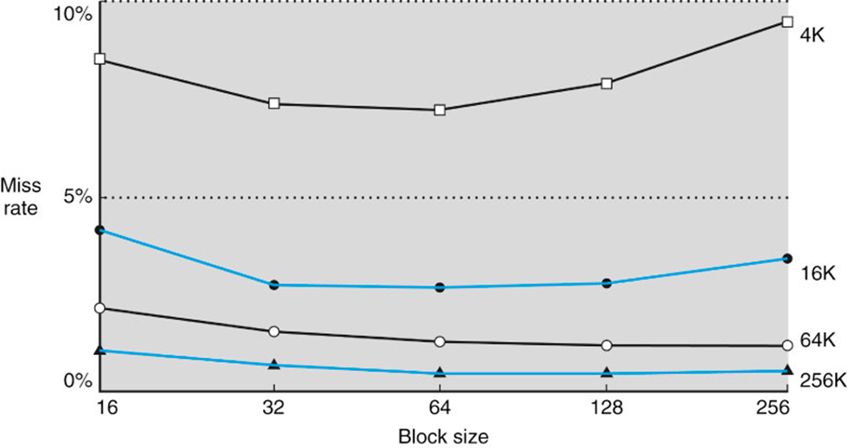
Cache with multiple words in a block
Research found: Increase block size will reduce miss rate, but may increase miss penalty.
The figure below shows when block size increases to 32 or 64 words, miss rate reduced.
Miss penalty: in case of a miss, have to bring up a “larger” block, thus cost more, i.e. higher penalty.
Here we introduced the concepts and advantage of cache with multiple words per block, details (implementation and operation) omitted.

Slide 11
Calculating Cache Performance
Assumption
Instruction cache miss rate: 2%
Data cache miss rate: 4% (freq. of load and store: 36%)
Miss penalty: 40 cycles
CPI=2 without any memory stalls (i.e. cache miss not considered)
How we’d proceed?
Similar to calculating pipeline performance.

Slide 12
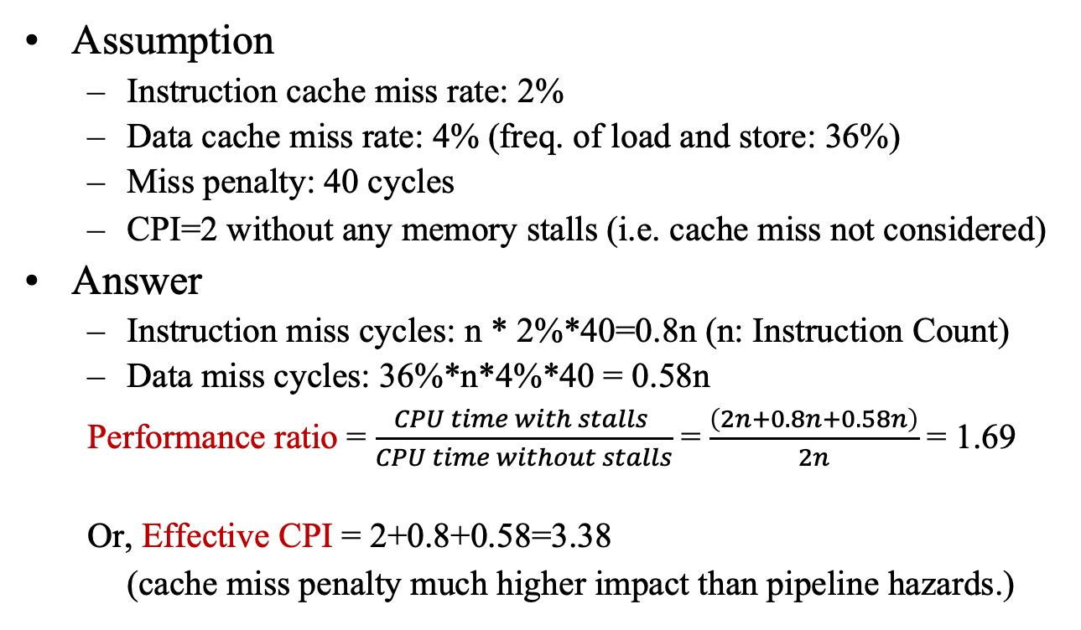
Calculating Cache Performance
Assumption
Instruction cache miss rate: 2%
Data cache miss rate: 4% (freq. of load and store: 36%)
Miss penalty: 40 cycles
CPI=2 without any memory stalls (i.e. cache miss not considered)
Answer
Instruction miss cycles: n * 2%*40=0.8n (n: Instruction Count)
Data miss cycles: 36%*n*4%*40 = 0.58n
Performance ratio = $\frac{CPU time with stalls }{CPU time without stalls}$ = $\frac{\left(2n+0.8n+0.58n\right)}{2n}$ = 1.69
Or, Effective CPI = 2+0.8+0.58=3.38
(cache miss penalty much higher impact than pipeline hazards.)

Slide 13
Performance Model
Simplified model: execution time = (execution cycles + stall cycles) × cycle time stall cycles = # of instructions × miss rate × miss penalty
Two ways of improving performance (i.e. to reduce stalls)
decreasing the miss rate
decreasing the miss penalty
How can we decrease miss rate?
How can we decrease the miss penalty?
We will introduce a number of basic strategies
Detailed implementation of these strategies are omitted here
More strategies discussed in Advanced Computer Architecture

Slide 14
Improving Cache Performance
Use split caches (i.e. IM and DM have own separate caches) to reduce miss rate because there is more spatial locality in code (one research result shown below)
Decreasing miss rate with set-associativity cache

Slide 15
Implementation of 4-way Cache
Direct mapped 4-word per block: if one word miss, the whole block needs to be replaced;
4-way: if one word miss then only replace one.
4-way advantage: lower miss rate
4-way disadvantage: more overhead.

Slide 16
Decreasing Miss Penalty with Multilevel Caches
Add a second level cache:
often primary cache is on the same chip as the processor
use SRAMs to add another cache above primary memory (DRAM)
miss penalty goes down if data is in 2nd level cache
Using multilevel caches:
try and optimize the hit time on the 1st level cache
try and optimize the miss rate on the 2nd level cache
very popular in multicore architecture
A good topic to study in team project
Discussion Question: What processor/technology you (your team) choose for the team project? What kind of cache used for that processor?

Slide 17
Summary
Fast memories are small, large memories are slow
We really want fast, large memories ☹
Caching gives this illusion ☺
Principle of locality
Programs use a small part of their memory space frequently
Memory hierarchy
L1 cache ↔ L2 cache ↔ … ↔ DRAM memory ↔ disk
Memory system design is critical for multicores or multiprocessors

